Slide 1
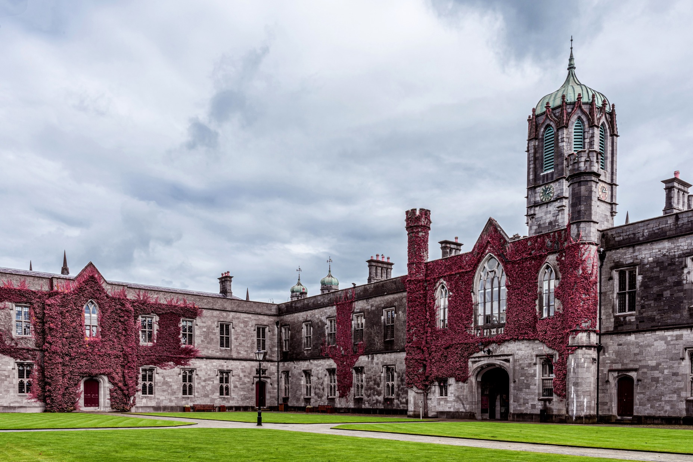
CT336/CT404 Graphics & Image Processing Sem 1 (Autumn) 2024-25, Dr. Nazre Batool 4th year B.Sc. (CS&I.T.). 2nd year M.Sc. (Software Development & Design) 1st year M.Sc. (Biomedical Engineering) Visiting students

Slide 2
~15 minutes for your valuable, honest feedback! External evaluator: Ms. Marilla Keating

Slide 3
Lecture 7: Edge & Feature Detection
Recap of Last Lecture(s):
Image Enhancement & Pre-processing via
Point & geometric transformations
Filtering (smoothing, differentiating) in Spatial and Frequency Domains
Binary Image Processing Pipeline using Morphological Techniques
Basic morphological operations (erosion, dilation, opening, closing, thinning, thickening)
Extraction of binary regions (connected components)
Distance Transform & Skeletonization
Properties of Binary Regions for choosing regions of interest
You will have an assignment task on implementing this complete pipeline!
Today – start understanding more complex operations on images:
Multiresolution processing & Image Pyramids
Edges
Feature Detectors & Feature Descriptors
Segmentation (Part 1 of 2)
Acknowledgement: These lecture slides have been prepared using digital materials available with your Text book: ‘Image Processing and Analysis by Stan Birchfield, 1st Edition, Cengage Learning’

Slide 4
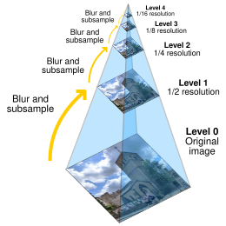
Multiresolution Processing
Multiresolution: To analyse the image at multiple resolutions (scales)
Image Pyramid:
A 40 X 40 region in the original image will occupy only a 20 X 20 region in the downsampled image, a 10 X 10 region in the twice downsampled image, and so forth.
Because each successive image is smaller than its predecessor, stacking the images on top of one another yields the shape of a pyramid.
The sequence of images is known as an image pyramid.
How to create image pyramids? Smooth -> downsample -> smooth -> downsample -> ….
Scale-space analysis
Image Pyramids (Gaussian and Laplacian)
Why is multiresolution processing beneficial?
Image source: Wikipedia

Slide 5
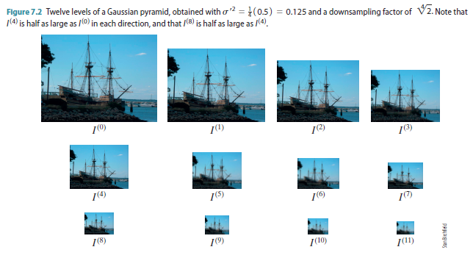
Multiresolution Processing
Gaussian Pyramid: smooth an image by convolving with a Gaussian kernel

Slide 6
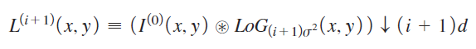
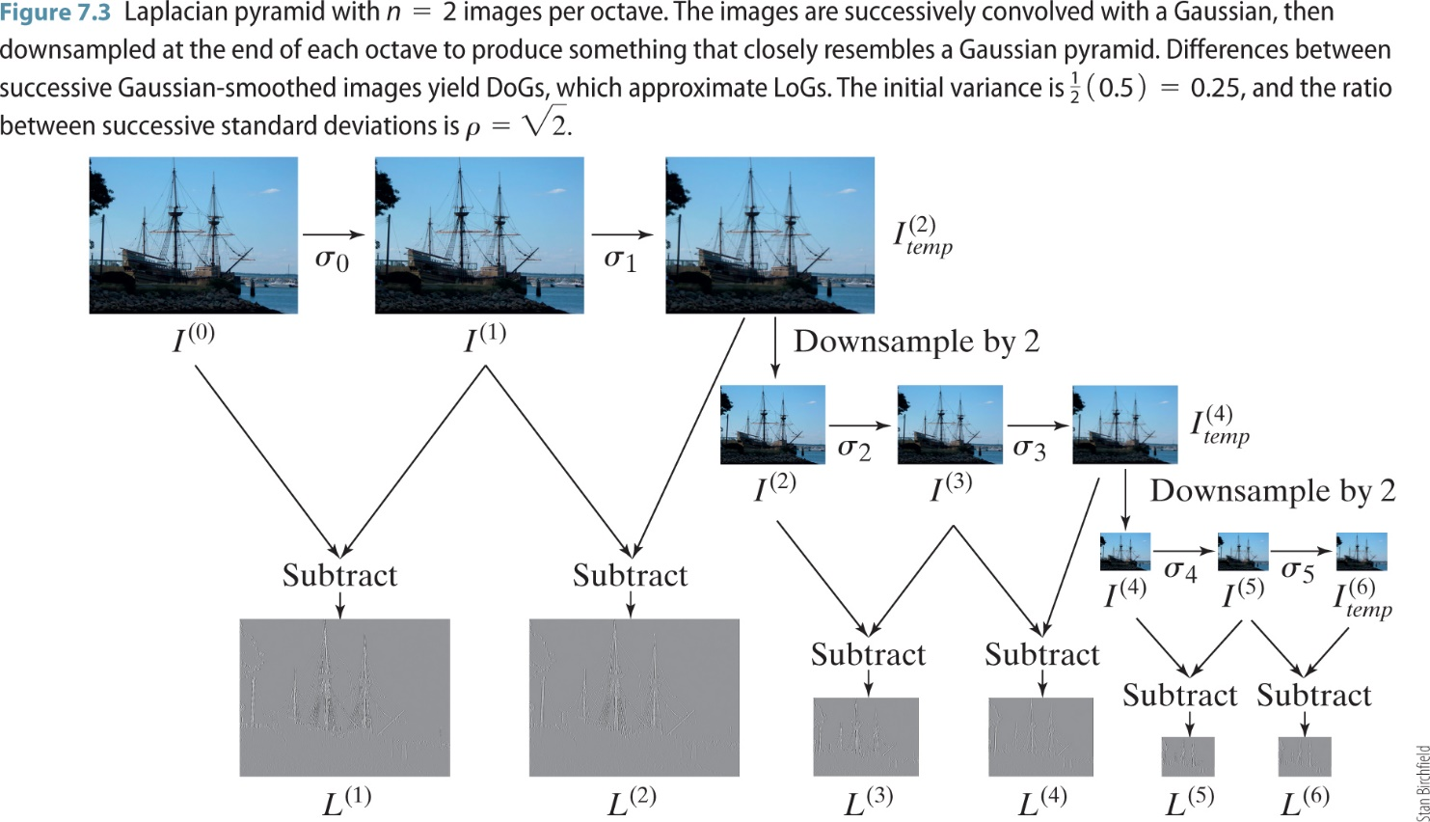
Multiresolution Processing
Laplacian Pyramid : smooth an image by convolving with several Gaussian kernels of varying variance, then take their difference DoG (Difference of Gaussian) to approximate LoG (Laplacian of Gaussian)

Slide 7
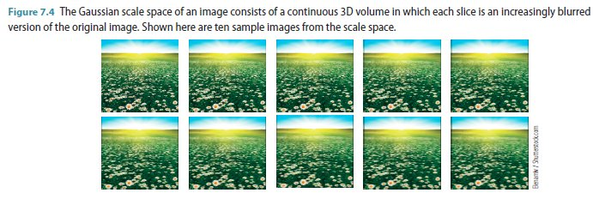
Multiresolution Processing
Scale-space : To construct a series of images at different scale-space an image is convolved with varying kernel sizes of Gaussian smoothing kernels of varying size and variance (‘scale’).
can be seen as an embedding of the original image into a one-parameter family of Gaussian kernels of increasing variance – being the continuous parameter.
The image size remains the same and not down-sampled
used in further image analysis techniques such as SIFT Features

Slide 8
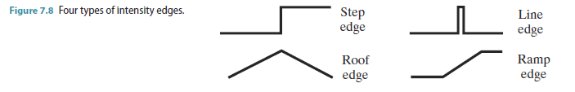
Edge Detection
Intensity edges are pixels in the image where the intensity (or graylevel) function changes rapidly.
Step edge: occurs when a light region is adjacent to a dark region.
Line edge: occurs when a thin light (or dark) object, such as a wire, is in front of a dark (or light) background.
Roof edge: the change is not in the lightness itself but rather the derivative of the lightness.
Ramp edge: occurs when the lightness changes slowly across a region.
Have we done any edge detection before?

Slide 9
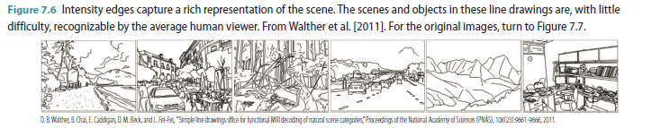
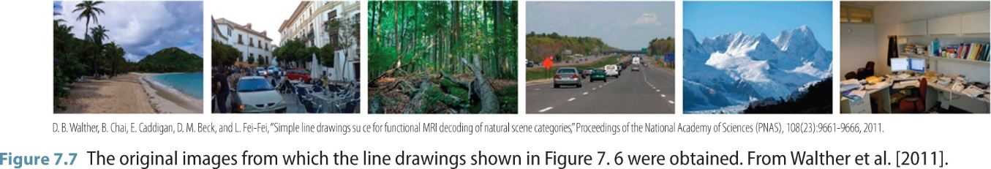
Edge Detection

Slide 10
Edge Detection
Canny Edge Detector: a classic algorithm for detecting intensity edges in a grayscale image that relies on the gradient magnitude.
The algorithm involves three steps:
First, the gradient of the image is computed, including the magnitude and phase.
Second, in non-maximum suppression, any pixel is set to zero whose gradient magnitude is not a local maximum in the direction of the gradient.
Finally, edge linking is performed to discard pixels without much support.
Highly regarded for a number of reasons:​
It has good ability to locate as many edges as possible​
It is relatively insensitive to noise​
There will be a minimal distance between its detected edges and the real edges (important when you want to measure/classify extracted objects)​
It gives only one response to each edge

Slide 11
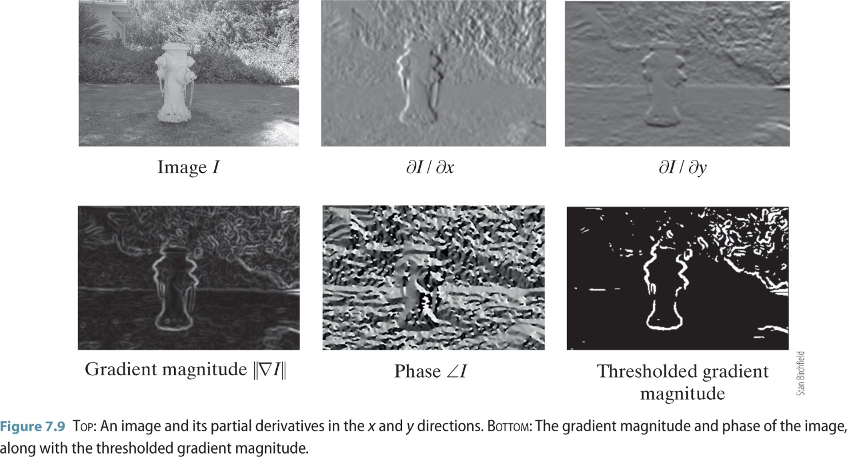
Edge Detection
Canny Edge Detector: a classic algorithm for detecting intensity edges in a grayscale image that relies on the gradient magnitude & phase.
The algorithm involves three steps:
First, the gradient of the image is computed, including the magnitude and phase.
Second, in non-maximum suppression, any pixel is set to zero whose gradient magnitude is not a local maximum in the direction of the gradient.
Finally, edge linking is performed to discard pixels without much support.
Recap: Gradient Magnitude and Phase

Slide 12
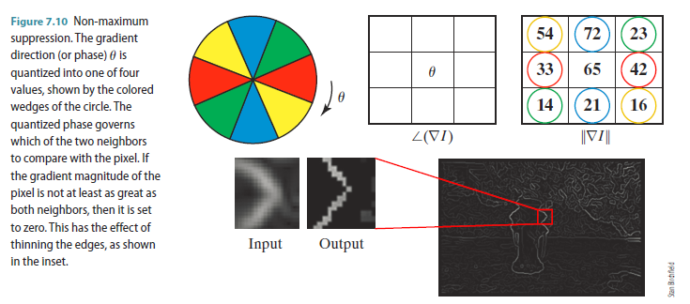
Edge Detection
Canny Edge Detector: non-maximum suppression

Slide 13
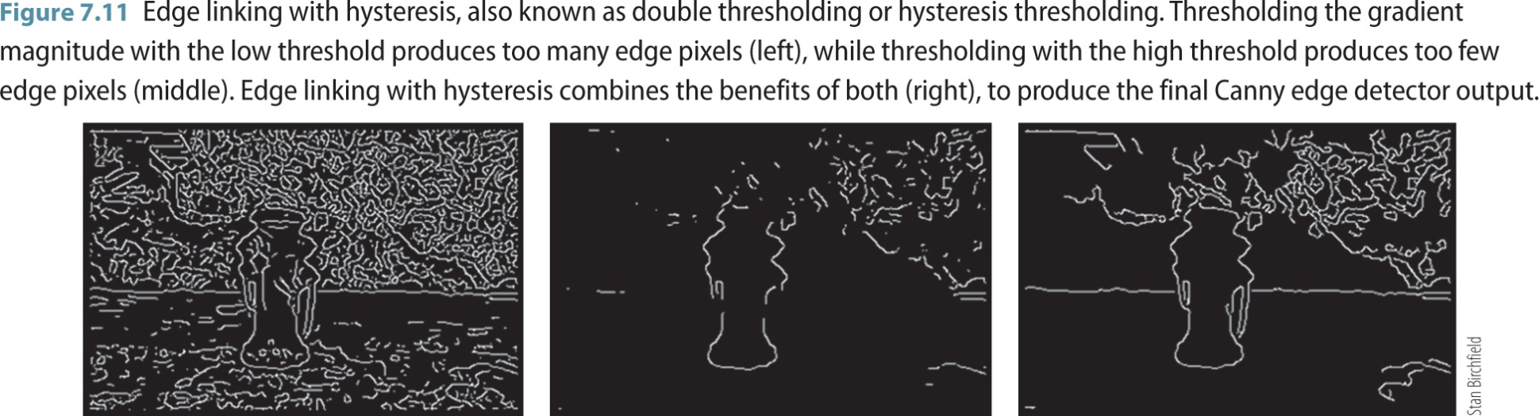
Edge Detection
Canny Edge Detector: Edge Linking

Slide 14
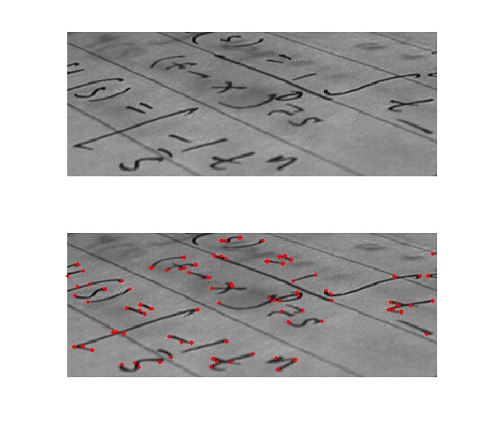
Feature Detection
An edge detector finds pixels with large gradient magnitude whereas a feature detector finds pixels where grayscale values vary locally in more than one direction.
One of the common places for features points is at Corners.
Harris Corner Detector
Tomasi-Kanade Feature Detector
SIFT Feature Detection
What are detected features useful for?
Frequently used in motion detection, object tracking, image registration, image stitching, 3D modelling, optical flow and visual odometry/SLAM (Robotics).

Slide 15
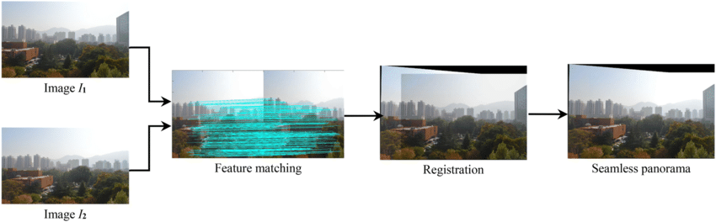
Feature Detection - Applications
Applications: Image registration, mosaic, stitching, panorama generation
Image source: Wang, Zhaobin & Yang, Zekun. (2020). Review on image-stitching techniques. Multimedia Systems. 26. 10.1007/s00530-020-00651-y.

Slide 16
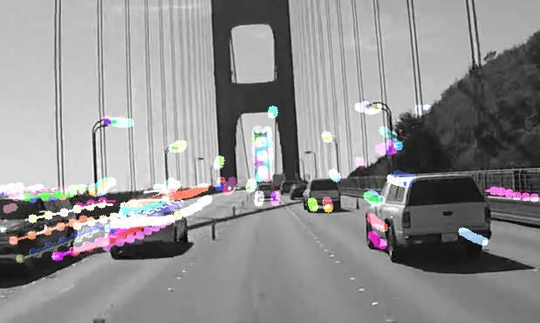
Feature Detection - Applications
Applications: Object Tracking and Optical Flow
Nvidia’s Pyramidal Lucas-Kanade (LK) Optical Flow algorithm
SLAM in Robotics using ORB features
These features are hand-crafted (as against those found by deep learning pipelines)
Good features are Scale-invariant and Rotation invariant
Application Dependent
Match or register images, classify or find objects by comparing these feature using supervised, unsupervised learning
Output Image, object, class, etc.
Pre-Processing
Compute Image Gradients
Use Feature Detectors to locate pixels with interesting image features
Use Feature Descriptors to calculate image features at these or other locations
Input Image

Slide 17
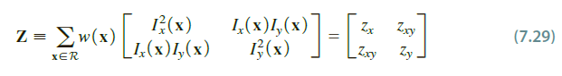
Feature Detection
Remember the Covariance Matrix, built from central moments, whose eigen values were used to find orientation & eccentricity of a (binary) region?
Now we build a Gradient Covariance Matrix/Autocorrelation Matrix from image gradients
Eigen values of Gradient Covariance Matrix indicate how the pixel values are varying in different directions.
Eigenvalues are inherently rotationally invariant. Why?

Slide 18
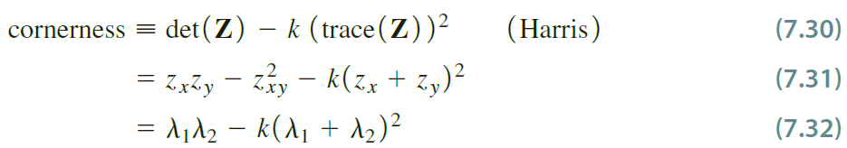
Feature Detection
Eigen values of Gradient Covariance Matrix
Both eigen values are large -> pixel values are varying in different directions
One eigenvalue is large -> indicate an edge with pixel values varying in one direction only.
Harris corner detector: Find pixel values with large ‘cornerness’ defined as follows
Tomasi-Kanade/Shi-Tomasi Detector: Find pixel values with large ‘cornerness’ defined as follows

Slide 19
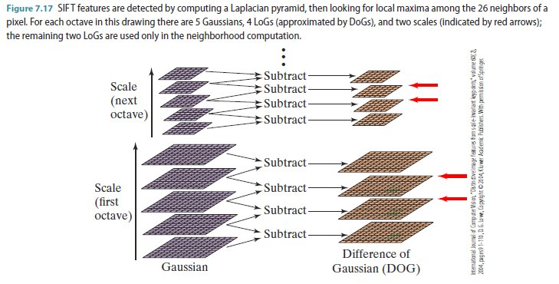
Feature Descriptors
Feature detector vs. Feature descriptor: What is the difference between their outputs?
SIFT Features
GLOH (Gradient Location & Histogram)
HOG (Histogram of Gradients)
SURF (Speeded Up Robust Feature) Features
ORB (Oriented fast and Robust BRIEF) Features
GABOR Texture Features

Slide 20
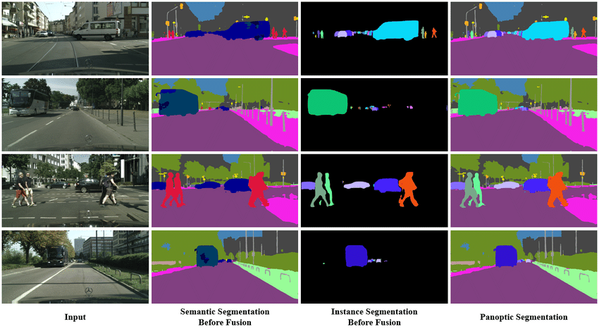
Image Segmentation
A fundamental image analysis task
A bottom-up process that groups pixels in an image based on their low-level properties such as colour or texture.
Three related tasks defined in recent years:
Semantic Segmentation: labels every single pixel contained in an image by its semantic class
Instance Segmentation: focuses only on the semantic classes that can be counted
Panoptic Segmentation: entails both of the above
Have you encountered any segmentation technique so far?
Fusion Scheme for Semantic and Instance-level Segmentation – Scientific Figure on ResearchGate. Available from: https://www.researchgate.net/figure/Panoptic-segmentation-by-unifying-semantic-and-instance-segmentation_fig2_329616112 [accessed 23 Oct 2024]

Slide 21
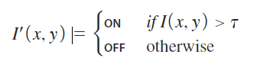
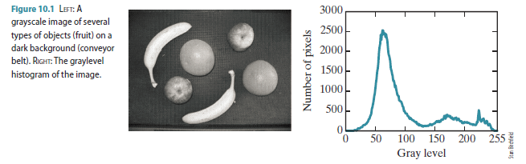
Image Segmentation
Global Thresholding: Let 𝜏 be a single global threshold. Once 𝜏 has been determined, it is applied to every pixel in a straightforward manner:
Two simple, widely used global thresholding technique are known as the Ridler-Calvard algorithm and Otsu’s method.

Slide 22
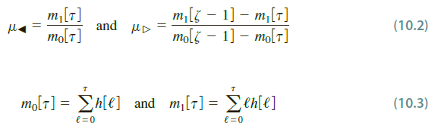
Image Segmentation
Global Thresholding Ridler-Calvard Algorithm:
Let 𝜏 be a threshold, and let 𝜇_⊲ be the mean gray level of all the pixels whose gray level is less than or equal to 𝜏, while 𝜇_⊳ is the mean gray level of all the pixels whose gray level is greater than 𝜏. If we assume that the background is darker than the foreground, then 𝜇_⊲ is the mean of the background pixels, whereas 𝜇_⊳ is the mean of the foreground pixels.

Slide 23
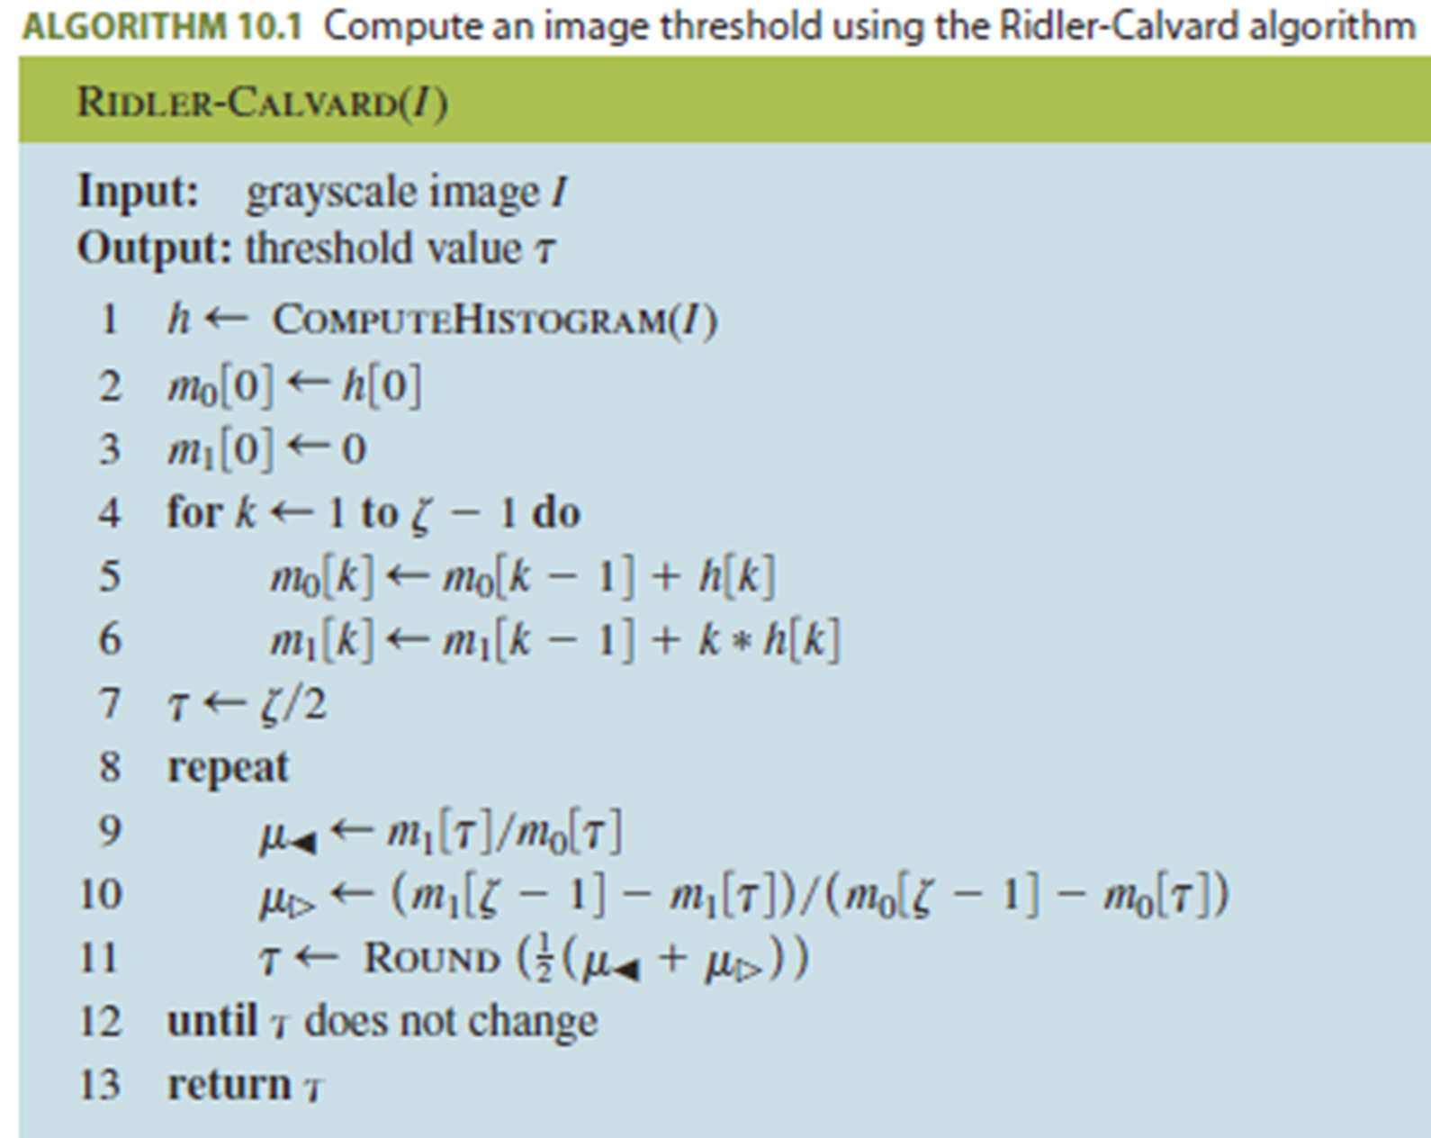
Image Segmentation
Global Thresholding Ridler-Calvard Algorithm:
Iterate between step 1 and 2 (similar to the ‘Expectation-Maximization algorithm’)
Step 1 (lines 9, 10): Computes the two means based on the current estimate of threshold.
Step 2 (line 11): Set the threshold to the average of the two new means.
Assumes that foreground and background gray levels are distributed as Gaussians with equivalent variance (and standard deviation).
What if the variances are different? Otsu’s Method

Slide 24
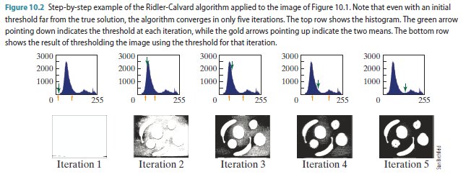
Image Segmentation
Global Thresholding Ridler-Calvard Algorithm:

Slide 25
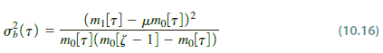
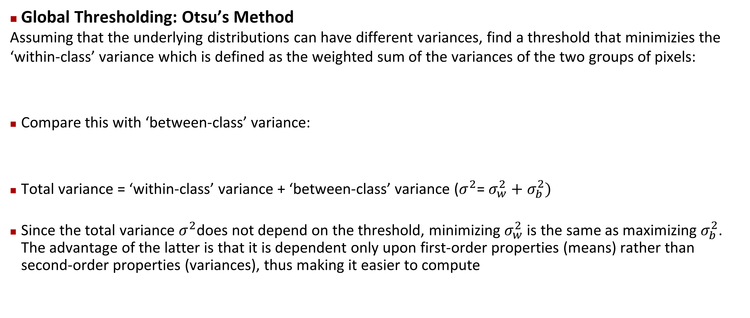
Image Segmentation
Global Thresholding: Otsu’s Method
Assuming that the underlying distributions can have different variances, find a threshold that minimizies the ‘within-class’ variance which is defined as the weighted sum of the variances of the two groups of pixels:
Compare this with ‘between-class’ variance:
Total variance = ‘within-class’ variance + ‘between-class’ variance ($σ^{2}$= $σ_{w}^{2}+$ $σ_{b}^{2})$
Since the total variance $σ^{2}$does not depend on the threshold, minimizing $σ_{w}^{2}$ is the same as maximizing $σ_{b}^{2}$. The advantage of the latter is that it is dependent only upon first-order properties (means) rather than second-order properties (variances), thus making it easier to compute

Slide 26
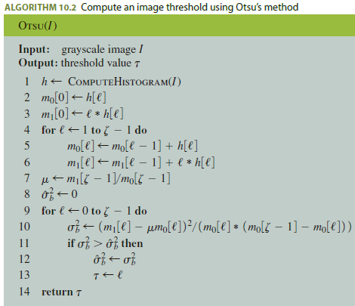
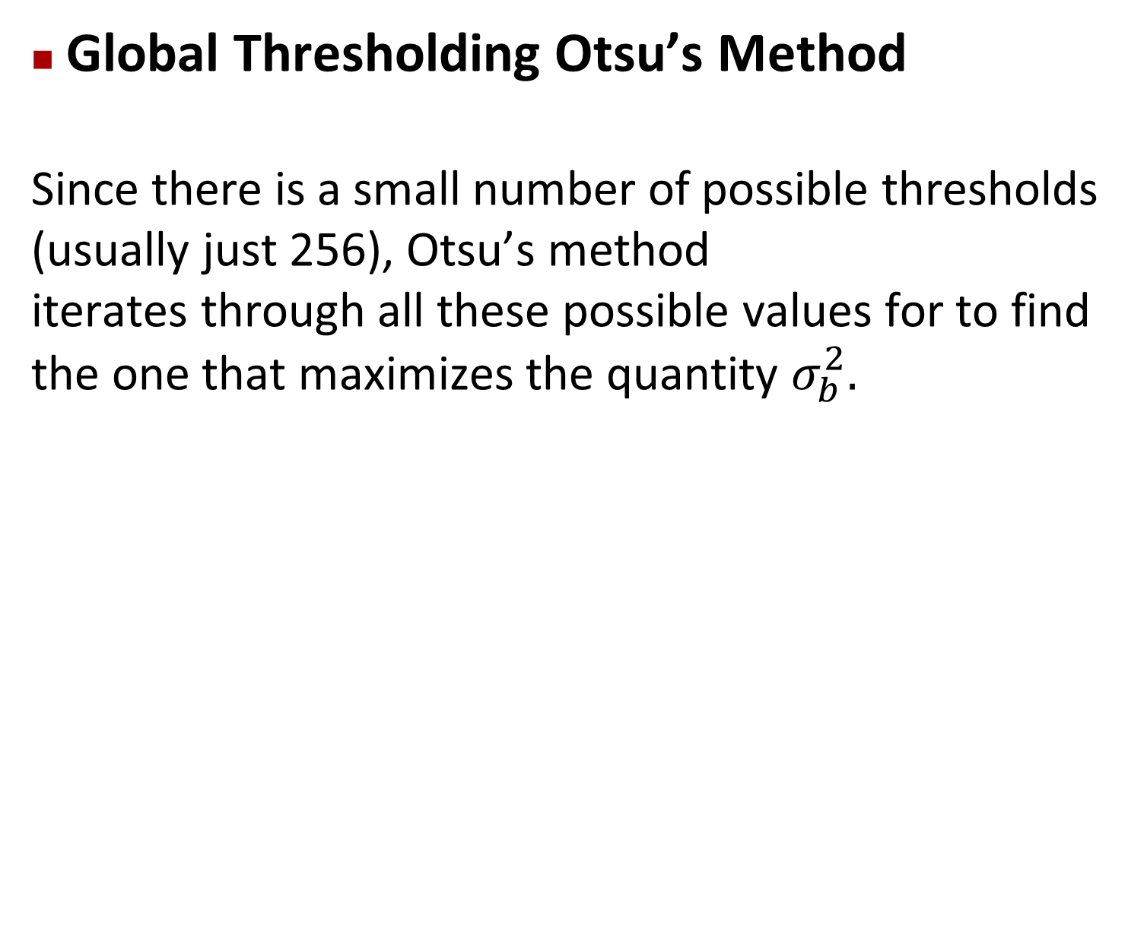
Image Segmentation
Global Thresholding Otsu’s Method
Since there is a small number of possible thresholds (usually just 256), Otsu’s method
iterates through all these possible values for to find the one that maximizes the quantity $σ_{b}^{2}.$

Slide 27
Next Time
Image Segmentation (Part 1 of 2)
Model Fitting

Slide 28
Thank you

